Slide 1
Welcome to Session 2

Slide 2

Housekeeping
Mobile phones on silent please
Safety exits, amenities etc

Slide 3

Recap Session 1 Objectives
To understand the psychosocial impact of vision loss.
To understand the referral and case management processes for GDQ Psychological Services.
To gain knowledge about psychological services internal and external to GDQ.
ANY QUESTIONS?

Slide 4
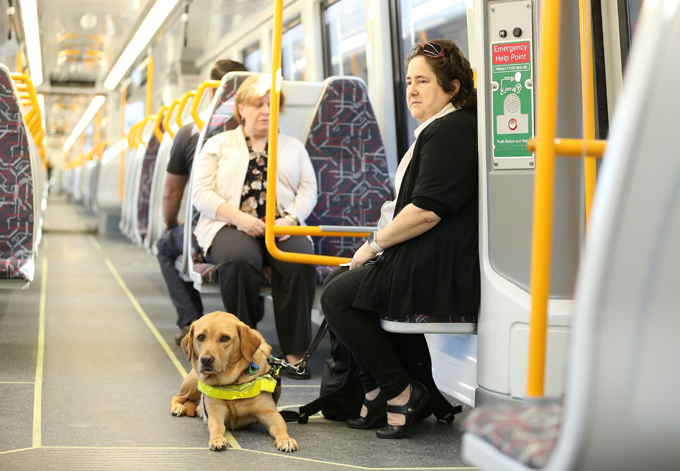
Session 2 Objective
To gain an understanding of mental health and to identify some of the more common mental health symptoms.

Slide 5
Mental Health
WHO Definition of mental health
Extracted from Investing in Mental Health, WHO, 2003

Slide 6
Mental Health
The wellbeing continuum
MENTAL HEALTH
MENTAL ILLNESS
Notes:
Mental illness becomes a problem when an individual’s emotional, cognitive, relationship and social capacities are impaired and as a result, affects a person’s quality of life. Mental health/illness can be seen as a continuum with no symptoms at one end and acute symptoms at the other.
What kind of symptoms sits on this continuum and when does it impact the person’s quality of life?

Slide 7
Cognitive Model
Event
Thoughts
(Thinking)
Physical Reactions
(Body)
Emotions
Behaviours
(Actions)
Notes:
Emotions are natural human responses. People often believe that an emotional reaction is caused by external events, situations, and the behaviour of others. However, this is a myth. Our emotional responses are evoked by our PERCEPTION of the situation or the behaviour of others. Thus, it is our thoughts and beliefs about an event that influences our feelings, physical reactions, and behaviours.
Often when we experience a significant change in our lives, for example losing our vision, we may experience high levels of stress. The uncertainty and unpredictability of the changes we may experience may lead to unhelpful thinking patterns. These thoughts influence our feelings, physical reactions, and behaviours.

Slide 8
Event
Pause, take 5.
Acknowledge the thoughts.
Provide reassurance.
Thoughts
(Thinking)
Pause, take 5.
Calm down.
Relax the body.
Physical Reactions
(Body)
Emotions
Change your plan.
Do something different.
Pause, take 5.
Acknowledge the emotions.
Calm down.
Behaviours
(Actions)
Notes:
TASK 3:
What do I do when I see these symptoms?

Slide 9
Let’s have a break

Slide 10
The journey of someone diagnosed with a vision impairment
Diagnosed
Loss of productivity
Loss of mobility
Loss of independence
Loss of confidence
Fear for personal safety
Loss of
self-esteem
Loss of hopes and dreams
Notes:
The journey of someone diagnosed with vision impairment without seeking any help.

Slide 11
The journey of a client with GDQ
Guide Dog services
Lifestyle & Leisure services
Assistive Technology services
Orientation & Mobility services
Occupational Therapy services
Psychological services
Diagnosed
Loss of productivity
Loss of mobility
Loss of independence
Loss of confidence
Fear for personal safety
Loss of
self-esteem
Loss of hopes and dreams
Notes:
The journey of someone diagnosed with vision impairment seeking support from GDQ. Explain the different services available.

Slide 12
The role of the psychologist at GDQ
Guide Dog services
Lifestyle & Leisure services
Assistive Technology services
Orientation & Mobility services
Occupational Therapy services
Psychological services
Diagnosed
Enhancing self-confidence
Redefining the self
Loss and Grief
Enhancing self-concept
Acceptance
Finding purpose in life
Depression
Anxiety
Trauma
Notes:
The impact of vision impairment on a person’s mental health

Slide 13
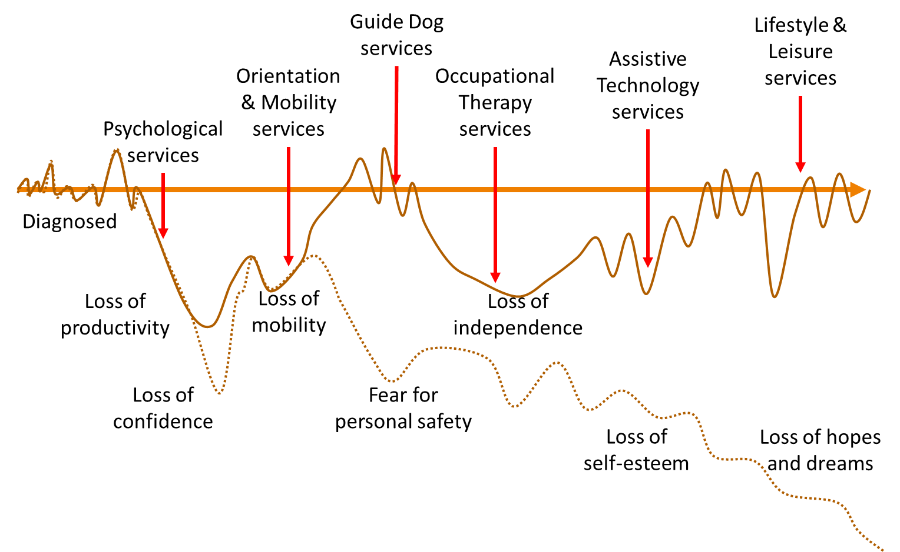
The journey of life
Diagnosed
Deterioration in vision
Natural aging impacting deterioration in vision
Natural life stressors impacting deterioration in vision
Notes:
The psychological impact is not an isolate incidence at the point of diagnosis of vision impairment but it is a repeated occurrence as the person journey through the rest of their life.

Slide 14
Mental Health
WHO Definition of mental health
The wellbeing continuum
MENTAL HEALTH
MENTAL ILLNESS
WHAT DO I DO??
Significant impact to emotions, cognition, relationship, and/or social capacity
Notes:
What do I do if I felt that a client may be presenting symptoms that may suggest they are closer to the mental illness continuum or have symptoms that were impacting on their training?

Slide 15
Referral Process
External agency
REFERRAL
Client
SELF REFERRAL
GDQ internal
REFERRAL
ASSESSMENT
INTERVENTION
Counselling Support
Better Living Program
External Referral
Support groups
Community Services
GP – Mental Health Care Plan
REVIEW
FOLLOW UP WITH CLIENT
Notes:
Have a chat with the GDQ Psychologist.
Review the referral process again and explain the Mental Health Care Plan

Slide 16

Case Study

Slide 17
End of Session 2

