Slide 1
Psychosocial impact of vision impairment on clients and their family
GDMI CADET TRAINING 2021
Notes:
Welcome to today’s session.
What does “psychosocial” means? Psychosocial health is a state of mental, emotional, social, and spiritual well-being. The psychosocial impact means the combined influence of all these factors on an individual within the context of his/her social environment.
When we look at the psychosocial impact of vision impairment, we often focus on the grief and loss around the vision loss.
Grief & Loss can be quite a heavy topic, but one which is important to discuss when providing a service to our clients. In order to keep the topic “light” and get the most out of this training, let’s establish some guidelines.
Firstly, acknowledge that we all experience grief and monitor any reactions you may have to our discussions. Please speak to us in the breaks if you need.
We will be focussing much of this training on our Guide Dog clients and in some cases, real scenarios may be disclosed. Please keep in mind the confidentiality undertaking that is part of our GDQ employment terms.
In training, we learn not just from the facilitators but from each other, and therefore adequate time for group discussion will be provided. We therefore encourage participation from each individual, whilst also endeavouring to cover relevant course material.

Slide 2

Housekeeping
Module consists of 3 half day sessions
Mobile phones on silent please
Safety exits, amenities etc

Slide 3
Getting to know each other
Notes:
Introduce each other and tell the group something that others may not have know already.
Disclose at your own personal level of comfort. Do not disclose anything you think may hurt or harm yourself or others.

Slide 4
Psychosocial impact of vision impairment on clients and their family
Notes:
Discussion about:
Why are we doing this?
Create awareness from within
Increase empathy not sympathy so we can help create a productive work relationship with clients
The uniqueness of the role of GDMI which encompasses two beings and the careful balance between them
Why do we need to do this?
Awareness and empathy do not always comes naturally.
Learning to take the role as a GDMI for both the beings under your care.
Explain the objectives for the model spread across 3 sessions.

Slide 5
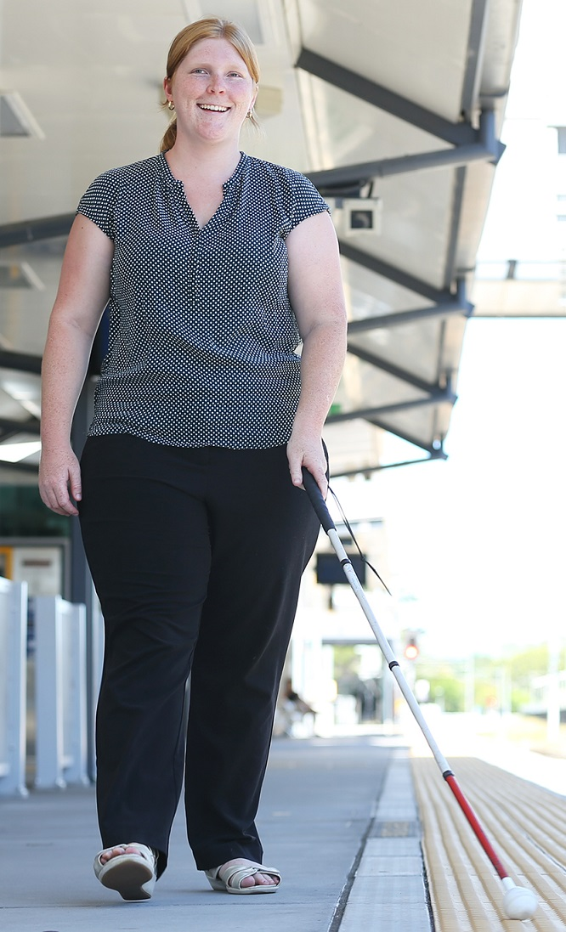
Session 1 Objectives
To understand the psychosocial impact of vision loss.
To understand the referral and case management processes for GDQ Psychological Services.
To gain knowledge about psychological services internal and external to GDQ.

Slide 6
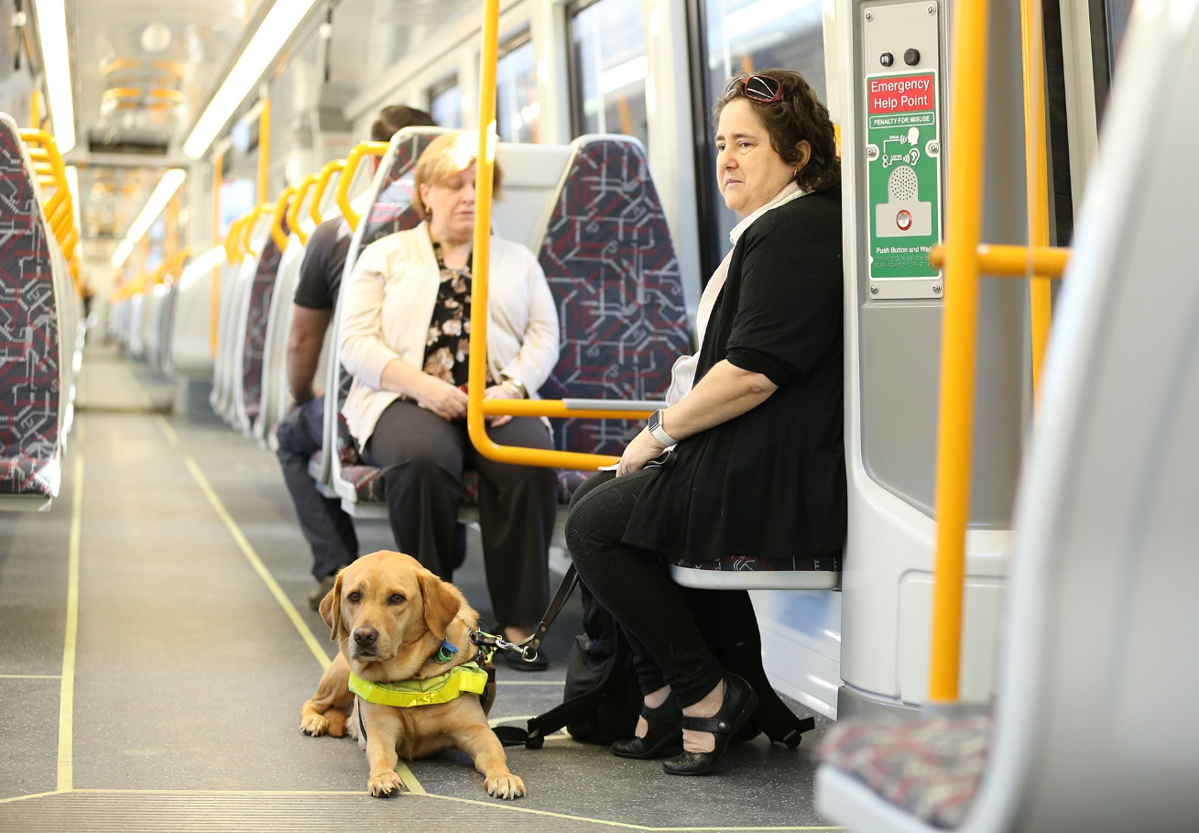
Session 2 Objective
To gain an understanding of mental health and to identify some of the more common mental health symptoms.

Slide 7
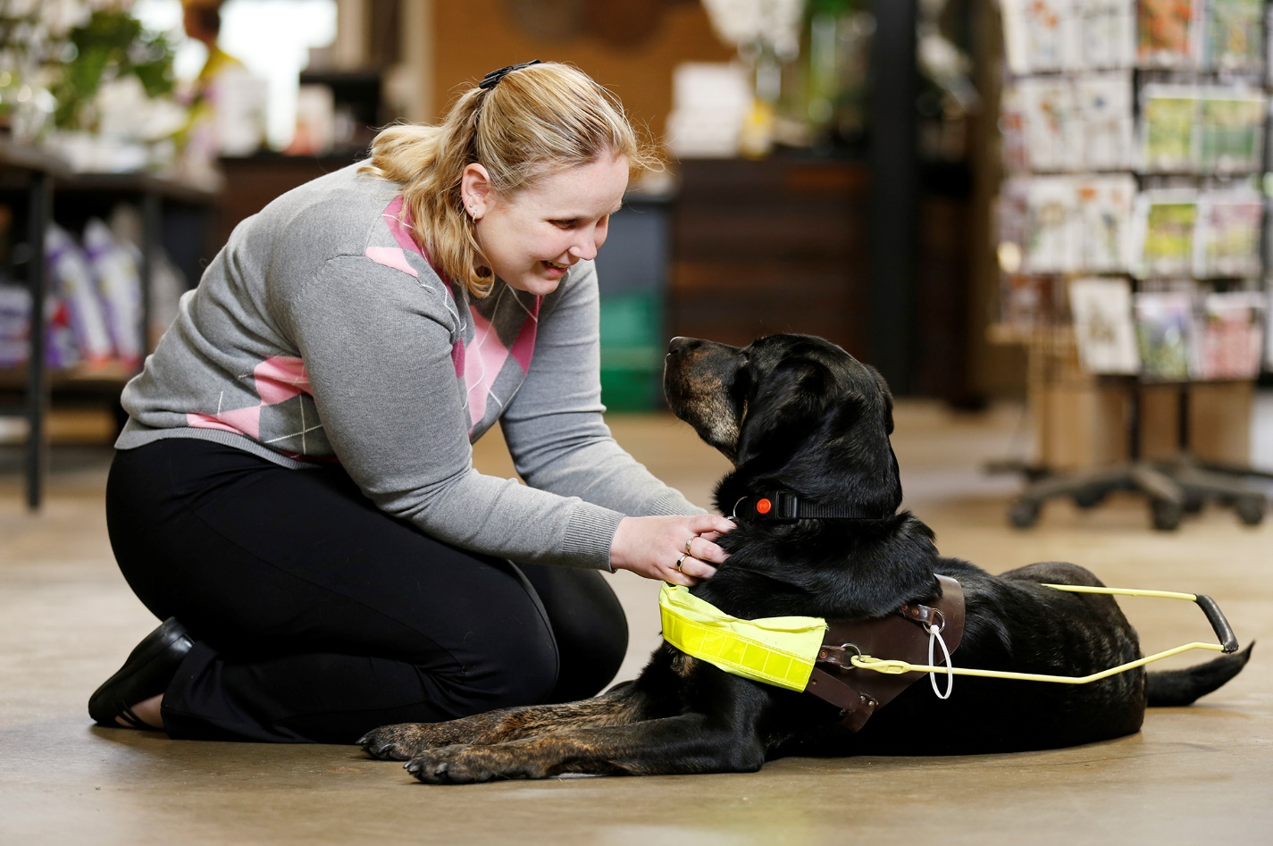
Session 3 Objective
To gain an understanding of some of the theoretical models of grief and to identify some of the more common grief reactions.

Slide 8
Session 1…What will we cover?

Slide 9
Session 1 Objectives
To understand the psychosocial impact of vision loss.
To understand the referral and case management processes for GDQ Psychological Services.
To gain knowledge about psychological services internal and external to GDQ.

Slide 10
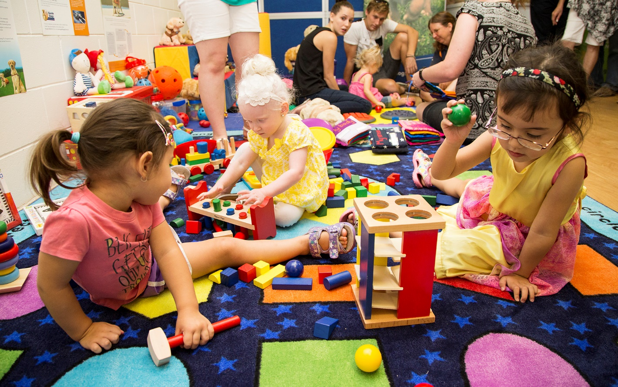
Session 1 Objectives
To understand the psychosocial impact of vision loss.

Slide 11



Loss and Grief
What is loss? What is grief?
Which comes first?
Driver Licence Licence No
000000001
DOB: 00/00/00
Height: 5 cm to 5cm
Expiry: 00/00/00
Conditions:
Unlimited driving
Notes:
ACTIVITY:
Distribute chocolates to everyone – explaining not to eat chocolates YET
Discussion about who LOVES chocolate. Some will LOVE chocolate, some will LIKE chocolate, some will be either way.
Take the chocolate back – and see what reactions occur
Explanation and discussion about LOSS – losing something and the reactions are dependent on the level of attachment or love of what is lost
Then ask participants to locate their driving licence. Remove the driving licence and ask them to describe what they felt they may lose when they no longer have their driving licence.
What comes first ?
Generally the loss (examples: death of loved one; divorce; pet; vision)
Followed by the grief (examples: emotions such as sadness, depression; frustration etc)

Slide 12
Activity
Grief Timeline
Notes:
ACTIVITY:
In pairs, draw a timeline on butcher’s paper, the various losses that can be experienced in human life from ages 0-20; 20-40; 40-60; 60-80
Discussion

Slide 13
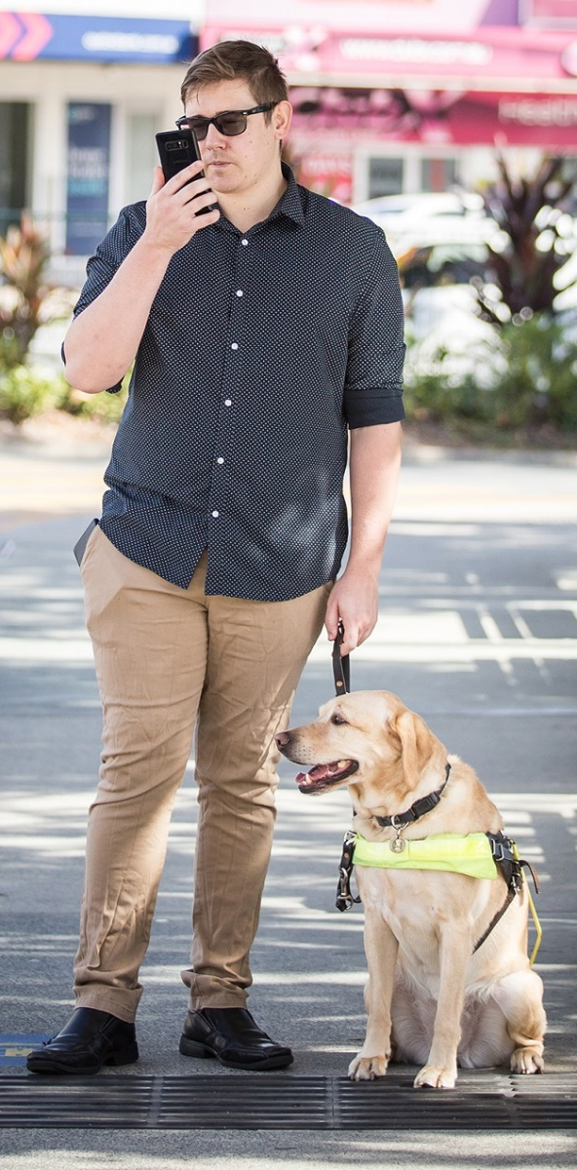
Our clients
Primary loss
  Loss of vision
Secondary losses
  Loss of independence
  Loss of confidence
  Loss of self-esteem
  No longer feeling safe
  Loss of hopes and dreams
  Loss of mobility
  Loss of productivity
  Change in satisfaction of previously enjoyable activity
Notes:
When we think about loss and grief, our clients encounter both primary and secondary losses.

Slide 14
Other obstacles…
Initial
  Sighted people don’t get it
  I just want to be treated the same
  Using a cane makes me stand out
  I feel like a burden on my partner
In later stages
  My employment opportunities are limited
  No one wants to be in a relationship with a person with vision impairment
In the further future
  I grieve for my old guide dog
Notes:
Vision impairment is a unique disability, given it is not always easy to see or understand by the sighted community. When someone can’t walk, they have crutches, a leg brace or a wheelchair, so we sighted people may “forget” the challenges of not being sighted. This can play out when we forget to put things back, or when we see someone with low vision reading. Many VIP’s have also complained that they are excluded from conversations which can be humiliating and embarrassing.
I JUST WANT TO BE TREATED THE SAME – having a disability means not having the ability to do things that others can. But it doesn’t mean that people with a disability feel or think any differently from others. Our clients want to be treated as normal, intelligent, worthy and capable human beings who have the power to chose to have a go at things, say yes or say no.
We often hear from our clients, that USING A CANE does highlight their disability and make them stand out in a crowd. Mobility aids are a great thing for safety, but not such a good thing for those who like to blend in. This can be a big hurdle for clients in their mobility training.
FEELING LIKE A BURDEN is something we hear regularly from our clients. This is often the case when independence is lost and when our vision impaired folk haven’t got a role either at work or in the home. Often this statement is directed to family.
EMPLOYMENT OPPORTUNITIES are indeed limited for anyone who has a disability, so our clients are experiencing financial issues because of unemployment as well as not feeling productive or being able to have that feeling of contributing or giving back.
NO ONE WANTS TO BE IN A RELATIONSHIP WITH A PERSON WITH VISION IMPAIRMENT – try helping someone write their online dating profile and pondering over whether to include the words “I’m vision impaired”. My clients have shared some unfortunate experiences about online dating where the vision impairment was disclosed or undisclosed. Unfortunately, people can be unkind particularly in situations that they don’t fully understand.
Last but not least, it is not always an easy transition from having one guide dog to the next.

Slide 15
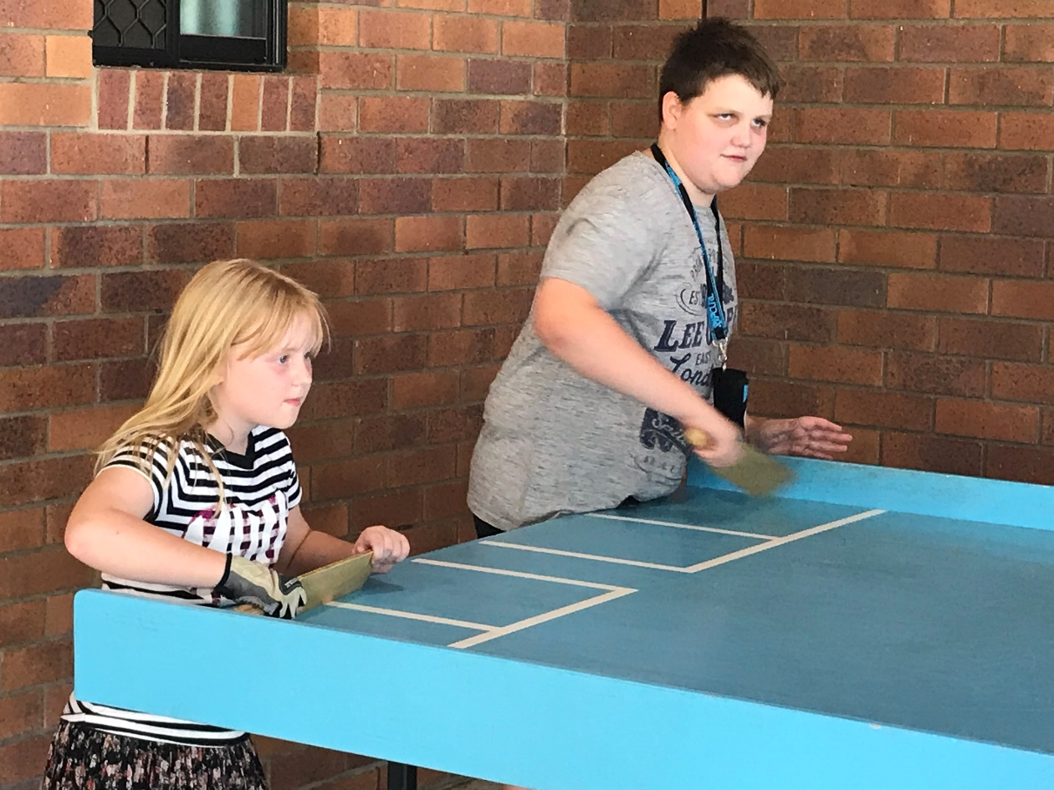
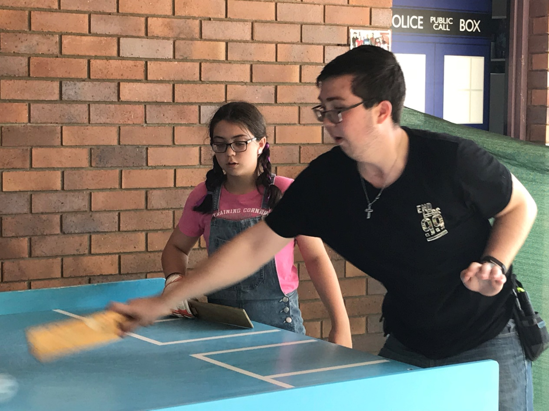
Other challenges…
not looking vision impaired
looking vision impaired
Notes:
Vision impairment is one of the few disabilities that is not obvious from the outset, especially with cortical vision impairment. Unless you have a dog or a white cane, you may not look vision impaired. And when you don’t look vision impaired, help or support isn’t always on offer.
Our clients tell us that they don’t want to look vision impaired. This is a bit of a contradiction, but many of our clients struggle at first with the idea of using a cane or mobility aid because this makes them stand out or appear different.

Slide 16
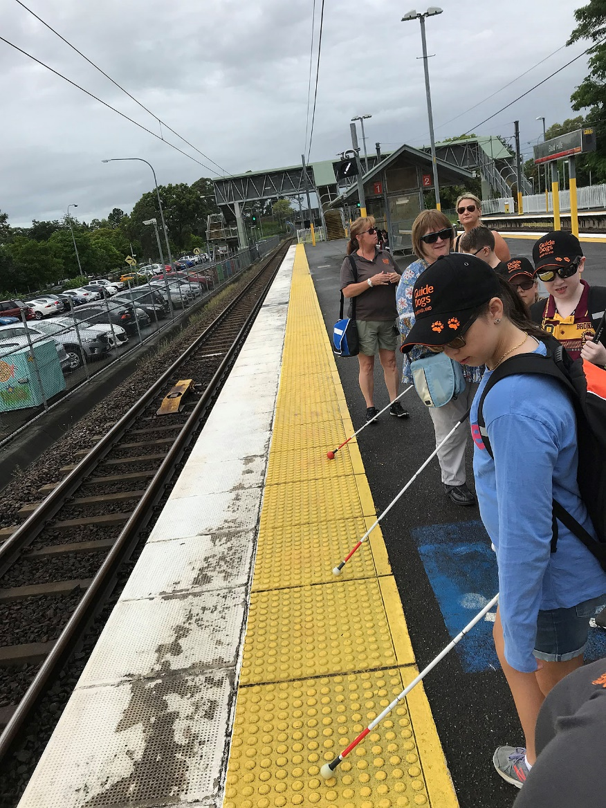
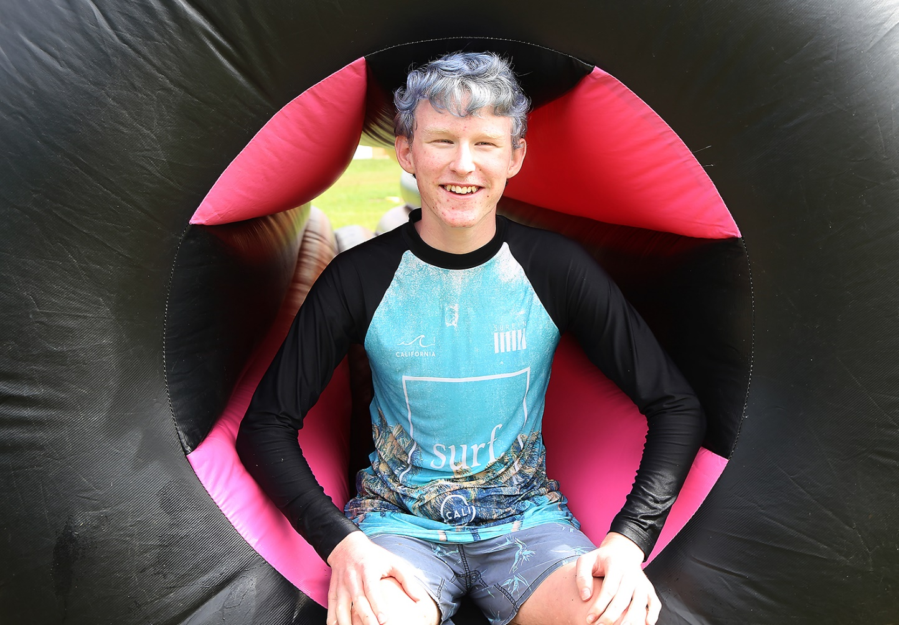
Other challenges…
not looking vision impaired
looking vision impaired
Notes:
Vision impairment is one of the few disabilities that is not obvious from the outset, especially with cortical vision impairment. Unless you have a dog or a white cane, you may not look vision impaired. And when you don’t look vision impaired, help or support isn’t always on offer.
Our clients tell us that they don’t want to look vision impaired. This is a bit of a contradiction, but many of our clients struggle at first with the idea of using a cane or mobility aid because this makes them stand out or appear different.

Slide 17
Other challenges…
“everything takes longer to do”
“I can’t find anything”
Notes:
Vision impairment is one of the few disabilities that is not obvious from the outset, especially with cortical vision impairment. Unless you have a dog or a white cane, you may not look vision impaired. And when you don’t look vision impaired, help or support isn’t always on offer.
Our clients tell us that they don’t want to look vision impaired. This is a bit of a contradiction, but many of our clients struggle at first with the idea of using a cane or mobility aid because this makes them stand out or appear different.
Everything takes longer to do when you are vision impaired and finding things such as remote controls or door keys is often challenging.
Finally, our clients struggle with holding on to their independence and asking for help.
It’s quite a balancing act to be able to let go of one’s pride and ask for help OR to say no when you want to do things for yourself.

Slide 18
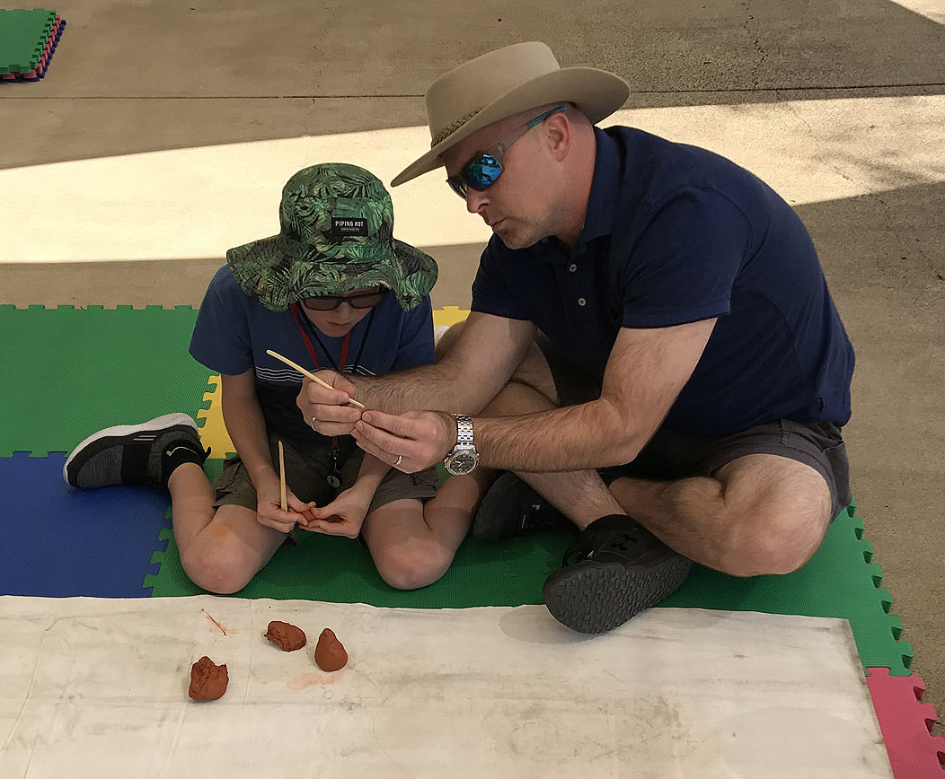
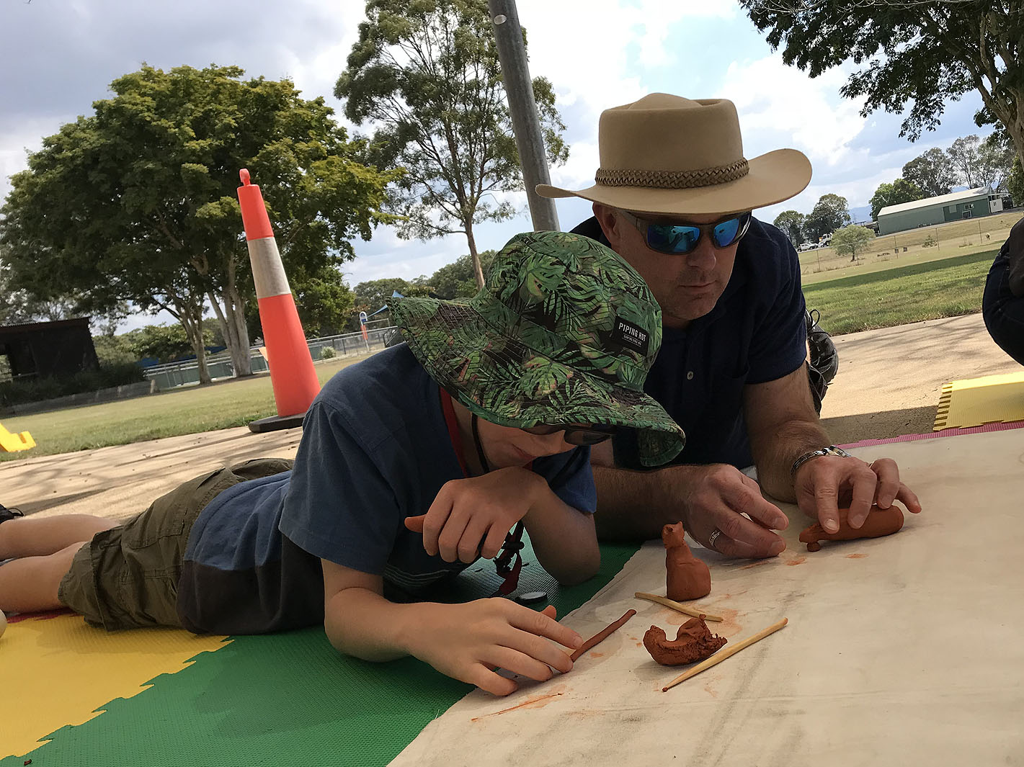
Other challenges…
“he won’t let me do it myself”
“how do I ask him to do it for me?”
Leave me alone,
I want to do it my way
Can you show me how vs
Notes:
Finally, our clients struggle with holding on to their independence and asking for help.
It’s quite a balancing act to be able to let go of one’s pride and ask for help OR to say no when you want to do things for yourself.

Slide 19
Let’s have a break and stretch

Slide 20
Session 1 Objectives cont…
To understand the referral and case management processes for GDQ Psychological Services.
To gain knowledge about psychological services internal and external to GDQ.

Slide 21
When to refer to GDQ Psychological Services?
Clients who are experiencing stress, depression and/or anxiety related to vision loss.
Acceptance and adjustment to vision loss for clients and their family members.
Clients who are experiencing self-esteem issues in relation to vision loss.
Clients who are needing emotional support with regard to mobility.
Clients who are needing emotional support with regard to guide dog
Clients who need emotional support to help re-engage with community.
External referral for support services or other relevant agencies.
Notes:
The GDQ Psychological Services aims to promote better understanding and acceptance of vision impairment for our clients. The service focuses on challenges around vision loss. If the clients presents with other mental health conditions outside of the scope of vision impairment, an external referral may be suggested.

Slide 22
GDQ Psychological Services
Counselling Support
  Centre-based or domiciliary counselling.
  Psychological support provided as part of residential classes.
  Short-term one to one counselling sessions for the individual and their family unit.
  Ranging from 3 to 20 sessions depending on the client’s needs/ goals.
  Generally focused on issues related to vision loss but it can also include mental health issues that may limit the client’s mobility or independent living.
Notes:
In your role as a Guide Dog Instructor, you will be working with clients who are experiencing loss of sight, suddenly or slowly. You will encounter some highly resilient people, but will also encounter others whose challenges may far outweigh their resources. Keep in mind that you are part of a bigger team, and referring to the counselling team may assist our client achieve his / her goals.
Some of the GDQ Psychological services include …

Slide 23
GDQ Psychological Services
Better Living Program
  Residential 4-day class
  Ranging from 3 to 5 participants
  Focused on the journey of vision impairment and skills to address signs of psychological symptoms.
Notes:
Some of the GDQ Psychological services include …

Slide 24
Referral Process
External agency
REFERRAL
Client
SELF REFERRAL
GDQ internal
REFERRAL
ASSESSMENT
INTERVENTION
Counselling Support
Better Living Program
External Referral
Support groups
Community Services
GP – Mental Health Care Plan
REVIEW
FOLLOW UP WITH CLIENT
Notes:
Generally speaking, counselling referrals are generated from within GDQ internally, from external disability or vision related services, and also from clients who self refer. After the initial referral, an assessment which entails gathering relevant information about the client, their support networks and their needs. A plan is then formulated to include which intervention is best suited to help achieve the client’s specific goals.

Slide 25
Case Management
ENGAGEMENT
Relationship building between client & agency
ASSESSMENT
Collection of client info, needs & current supports etc
PLANNING & ALLOCATION
Services team meet to develop case plan
IMPLEMENTATION
Service delivery
REVIEW/CLOSURE
Notes:
Many of our clients will benefit from counselling whilst undertaking mobility or guide dog training. Co-ordination between the Psychology, Mobility and Guide Dog Services teams is a collaborative process which entails planning, communication and support co-ordination.

Slide 26
Practice Framework
O&M
Services
AT Services
GDMI
Services
Pathways
& NDIS
Lifestyle & Leisure
Client’s
Needs
OT
Services
Psychological
Services

Slide 27
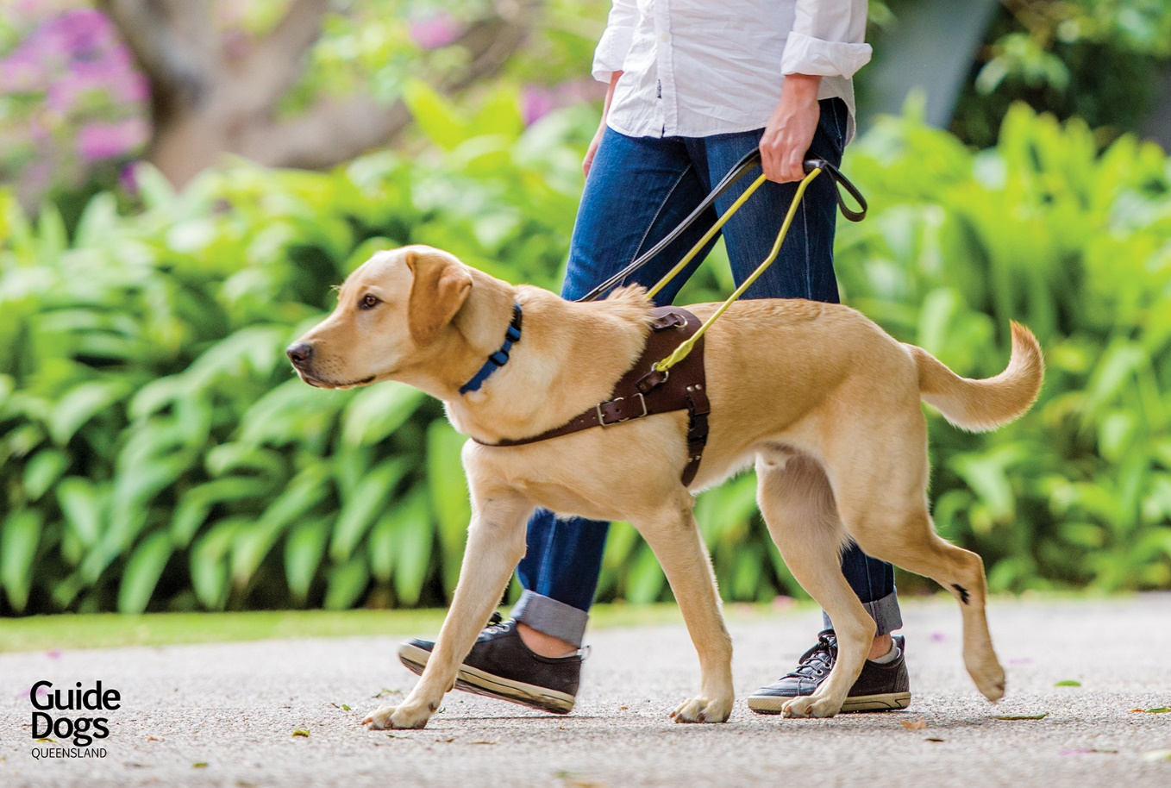
Case Study

Slide 28
End of Session 1

