Slide 1
Professional Practice
GDMI CADET TRAINING 2021

Slide 2

Housekeeping
Mobile phones on silent please
Safety exits, amenities etc

Slide 3

Session 1 Objective
Understand professional practice within a human services employment role.
To develop and demonstrate a toolbox of communication skills when working with clients.

Slide 4
Session 2 Objective
To identify and learn positive self-care strategies for working in the helping industry.
YOU

Slide 5
Session 1 Objective
Understand professional practice within a human services employment role.
Notes:
What is professional practice and why is it important?

Slide 6
Session 1 Objective
To develop and demonstrate a toolbox of communication skills when working with clients.
Notes:
What is the definition of communication?
Communication is the art of sending ones thoughts to others, who then receive and understand these thoughts. Communicating with people with vision impairment can sometimes be tricky, given this means communicating with people who may not see our reactions or our body language, both of which are important factors which help us transmit our message. Research suggests that non-verbal channels of communication relay important information and that those channels can sometimes be more powerful than what people actually say. We should therefore be mindful of non-verbals like voice tone and touch and check in with our clients that our messages are received and understood.
Read article “Over There”

Slide 7

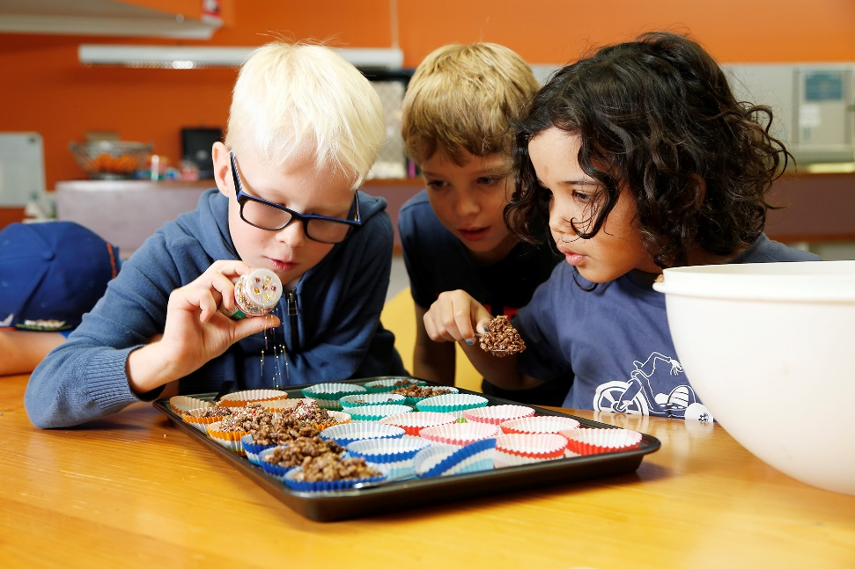
Communication and Professionalism
Purpose of communication
  to build rapport
  to inform
  to educate
  to support
  to listen
  to negotiate
NOT to …
  solve
  fix
Notes:
Our role in Guide Dogs Queensland can involve informing and educating our clients as well as sometimes supporting them in their anguish or frustrations. It goes without saying how important getting our message across is. When we reflect on a time when we felt really supported and understood, it is often because we felt really listened to. We might have noticed that the other person didn’t try to ‘solve’ or ‘fix’ our problems but instead affirmed how we felt.
Client focused communication

Slide 8
Building Relationships
Respect for your client
  treat your client as if they are important
  use their name
  return their calls
  start sessions on time
  dress professionally
  have paperwork ready for them

Slide 9
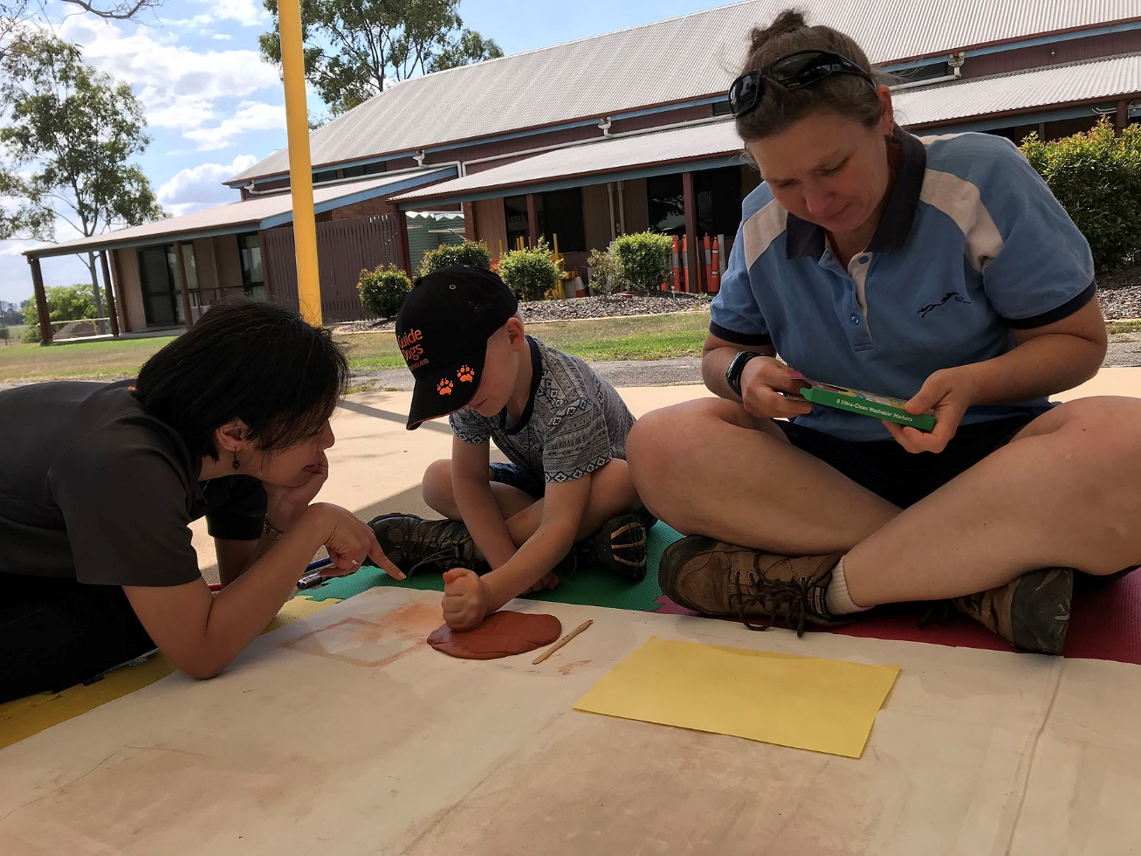
Building Relationships
Communication Styles
  direct
  light hearted
  humorous
  quiet
Notes:
Communication styles
become aware of your client’s language and communication style and where possible, match it
there are four communication styles
DIRECT - while no nonsense and to the point, direct communicators require us to tone back our zeal somewhat and keep to task.
LIGHT HEARTED - they rarely need prompting to provide conversation, but be mindful of your role and keep the session on track to achieve optimum results.
HUMOROUS - our clients who laugh easily can allow us to show humour of our own, but always ensure that no insensitive or offensive remarks are made.
QUIET - our quiet clients who say little without prompting, may be shy or nervous and therefore require us to respect their style and scale back accordingly, while also looking for relevant opportunities to ask them to elaborate or contribute.

Slide 10
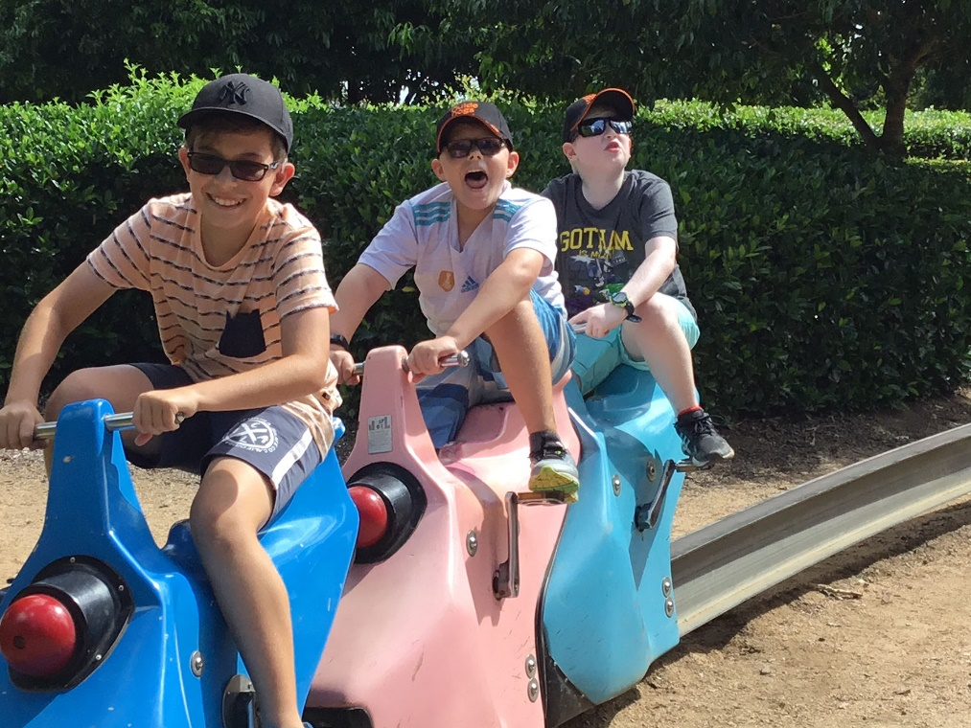

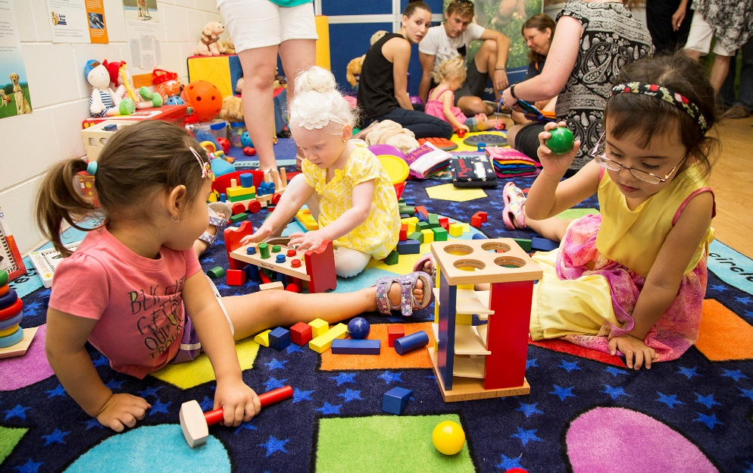
Building Relationships
Learning Styles
  Auditory
  Visual
  Tactile Kinaesthetic
Multiple Intelligences
Notes:
Learning Styles
Make note of how our clients express themselves which may reflect their preferred learning technique.
We all have a preferred learning style (3 main sensory receivers):
Auditory – Client respond to verbal instructions or expressions. Client may engage in lengthy conversations to understand the process. Take time to allow the client to express and listen or process the information.
Kinaesthetic – Clients respond to physical demonstration. Client prefer that you show them how to perform tasks rather than lengthy verbal descriptors.
Visual – Client respond to visual representation of the object or task. Client prefer to have a visual model to supplement verbal descriptions of the task.

Slide 11
Building Relationships
Self-disclosure
Cultural diversity and sensitivity
Notes:
Self disclosure
Self-disclosure can be as helpful as it can be damaging if not properly conducted. The benefits of using self-disclosure include helping our client to not feel alone, decreasing client anxiety and improving our client’s awareness to different viewpoints. Some disadvantages of applying self-disclosure include moving the focus from the client, taking too much of their time and thus reducing their opportunity to disclose. Disclosing personal information can be a great way to build rapport but be careful with this one.
Cultural diversity and sensitivity
Be aware of culture diversity in the population we are working in. Be open to understanding and accepting the cultural differences of others. Be mindful of our own cultures and not to impose our cultures to others. Culture influences a person’s thinking patterns which in turn, influences the person’s emotional reactions and behavioural responses.

Slide 12
Let’s have a break

Slide 13
Activity
Communication
Notes:
TASK:
Form pairs and position your chairs. One person will be talking and the other, listening. Have a conversation about a situation which is causing you concern, either personal or professional. After a few minutes, reverse the roles. Now, write down some ways that you felt listened to by the other person, other than making eye contact

Slide 14
Communication Tools
Active listening
Summarising
Paraphrasing
Minimal encouragers
Closed questions
Open questions
Notes:
Active listening helps to confirm the understanding of both parties. When interacting, we often wait to speak rather than listen attentively which can cause us to get distracted. Active listening is a structured way of listening and responding to others, focusing attention on the function of communication objectively.
Summarising involves taking what someone has said and reducing it down into a sentence or a few sentences that condense what might have taken a few minutes or longer to say. An example might be:- “So, you are enjoying your new dog but feel a bit overwhelmed with everything that is involved.”
Paraphrasing involves repeating what has been said by putting it in your own words. This skill is very useful for helping the client find the exact words they might be looking for, for example:-
Client: “I am not getting anywhere, there’s just so much to learn”
You: “you feel overwhelmed?”
Client: Yes, actually I am feeling so overwhelmed”.
Minimal Encouragers are small signals that let our clients know that we are listening and understanding. Words like “uh-huh”, “yes” and “mmm” show that you are engaged in listening. These small words encourage the client to talk, with minimum interruption or influence. Once the client begins to talk, well placed minimal encouragers will not interrupt their thoughts, but may encourage them to reveal even more.
Closed questions are a great way to break or interrupt a long ramble. Quite simply, closed questions can be answered with one word, for example, yes or no. They have the following characteristics:
they give you facts
they are easy to answer
they are quick to answer
they keep control of the conversation
Open questions are likely to receive long answers. They usually begin with what, why, how or describe. Using open questions can be scary as they seem to hand the baton of control over to the client. However, well paced questions do leave you in control as you steer the client’s interest and engage them where you want them to go. Open questions have the following characteristics:-
they ask the client to think and reflect
they will give you opinions and feelings
they hand control of the conversation over to the client

Slide 15
Managing communication
Interrupting politely and respectfully
Reluctant client
Abuse, passive aggression, or rude clients
Difficult client (e.g., argumentative, bad mood, highly emotional)
When you get caught off guard (a deer in the spotlight)
Notes:
Role play different scenarios with the following case studies

Slide 16
Let’s practice your skills with some case studies

Slide 17
End of Session 1

